Slide 1
Crisis Management
Awareness Session

Slide 2
OVERVIEW
Crisis Management Background and History
Crisis Management Training 101 Video
Emergency Response Flip Guide
Interactive Discussion

Slide 3
Crisis Management Leadership
Crisis Management Support Team (CMST): October 2014
Doug Sutten Deb Limb
Dave Eller Rashelle Tanner
Kyle Roquet Ben Wilson
Randall Hashimoto Joyce Powell
Emergency Preparation Meetings: October 29-31, 2014
Doug Sutten Deb Limb Dave Eller
Rashelle Tanner Kyle Roquet Ben Wilson
Randall Hashimoto Joyce Powell Wayne Dobbs
Kevin Peterson Shane Carlson Bryan Hubert
Michael Kerrick Glenn Morse Stan Mak
Debra Webster Robin Skeen Steve Landis
Amy Timoll Eric Rasmussen

Slide 4
Crisis Management Initiatives
Emergency response improvements throughout CRISTA facilities (i.e. monitoring systems, lockdown hardware and emergency response resources, et al.)
Enhanced emergency response communication infrastructure
Coordinating first responder and CRISTA staff emergency response training
Emergency Response Flip Guide

Slide 5

Annual Fire Facts (USA 2013)
Over 480,000 structure fires involving 14,000 injuries and 2,800 deaths
$9.5 Billion in
property damage
Most common causes of structure fires:
Cooking Equipment (19%) Intentional (18%)
Heating Equipment (9%)
Most common causes of nursing center fires:
Cooking Equipment (54%) Laundry Equipment (12%) Heating Equipment (9%)

Slide 6

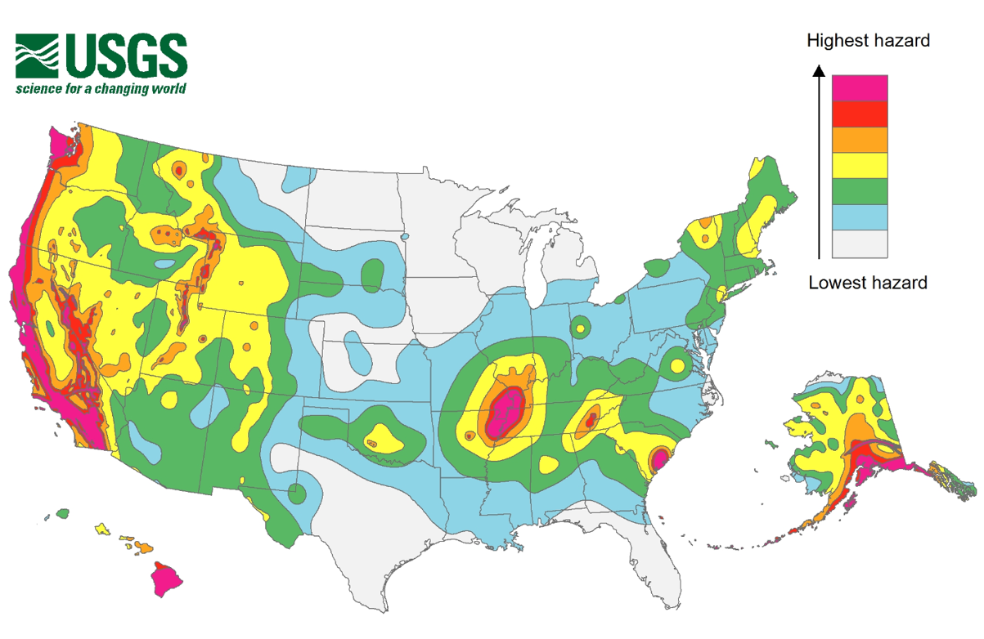
Earthquake
Shoreline & Kitsap County
are in the highest
Earthquake hazard zone.
Primary danger during an
earthquake is being struck
by falling debris.
Earthquake hazard
identification planning
and mitigation reduces
the risk of injury.

Slide 7

Active Shooter
160 incidents between
2000 and 2013
with 1,043 casualties
(killed and wounded)
Lockdowns work and are still one of the most effective tools available to get students and staff out of harms way
Time is a huge factor in response tactics:
69% ended in
5 minutes or less
Unarmed citizens ended a significant number of events (13%)

Slide 8
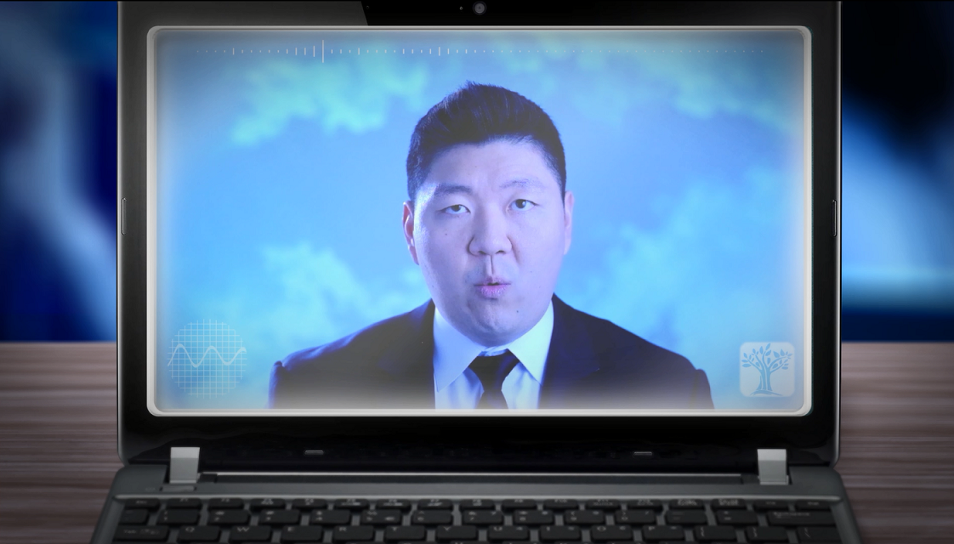
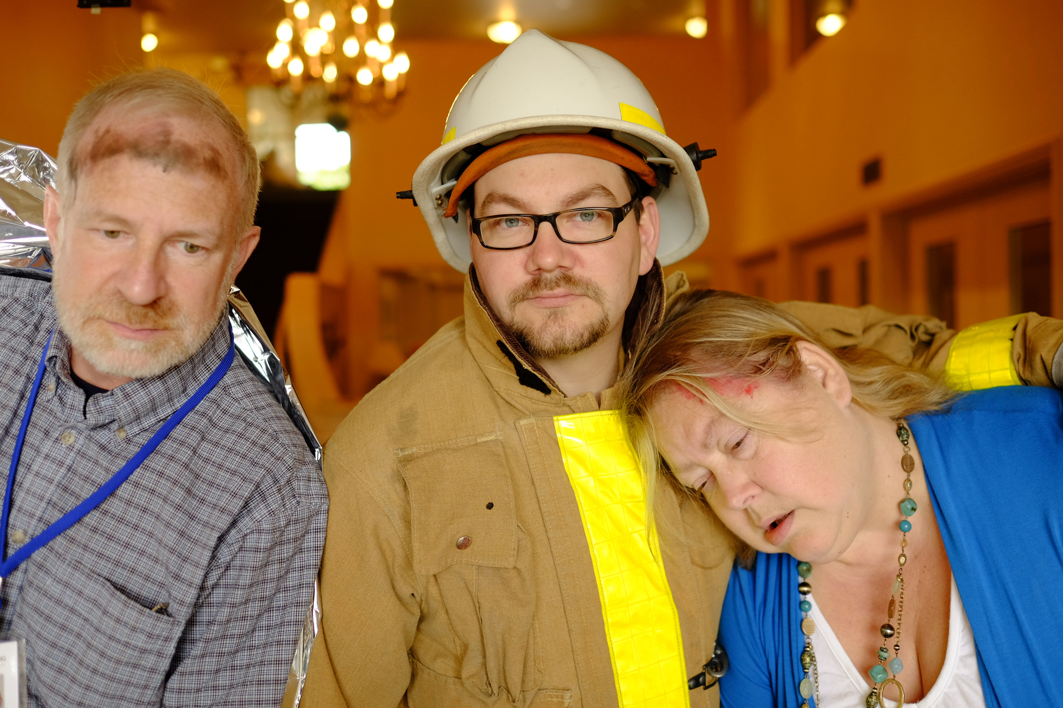
Crisis Management Training 101

Slide 9
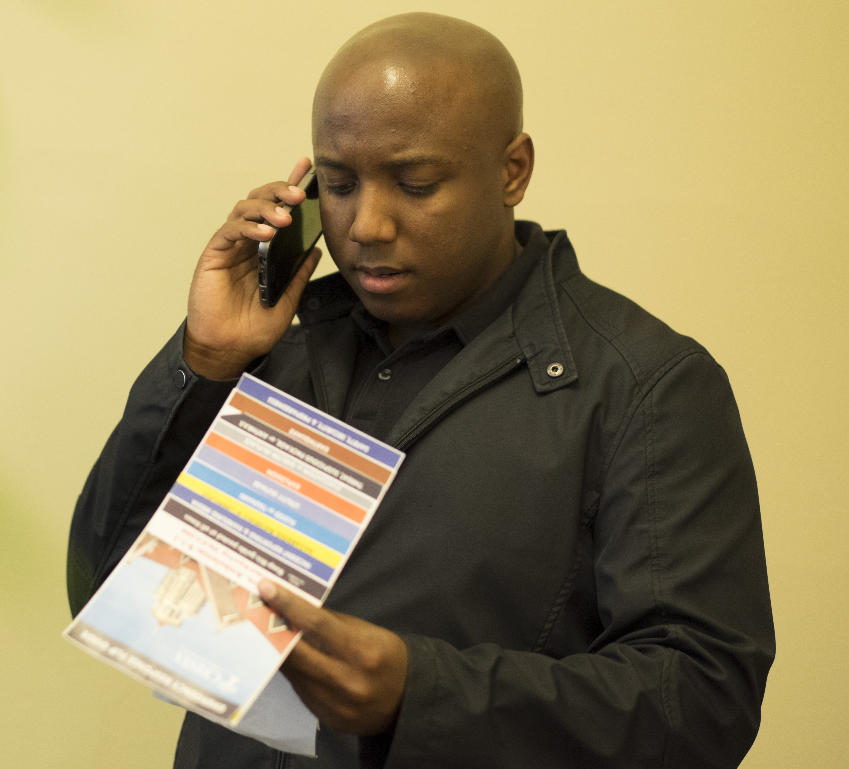
Emergency Response Flip Guide

Slide 10
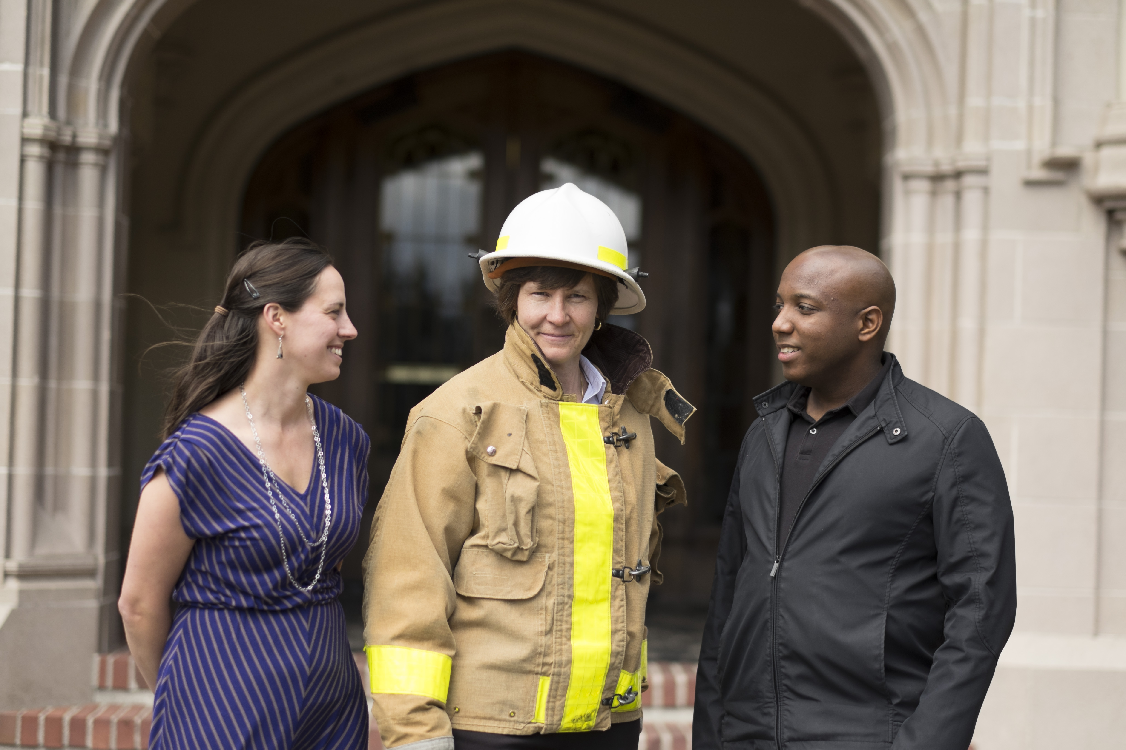
Interactive Discussion

Slide 11
Interactive Discussion
Discuss the emergency response resources in your work area
Discuss practical responses to different emergency scenarios
Discuss proactively preparing for an emergency

